Slide 1
Limitations of array
Fixed size.
Can store data items of same type.
Therefore to overcome this limitation c programming provides structures.
Notes:
Example student details – name in characters, age in intergers, marks in float

Slide 2
Structure
Structure is a user defined datatype
Structures allows to combine data items of different types
Therefore we define structure as a collection of elements which are of different datatypes.
Keyword : struct

Slide 3
Structures are used to represent a record.
Suppose you want to keep track of your books in a library. You might want to track the following attributes about each book −
Title
Author
Pages
Cost
Storing student record
Name
Roll no
Marks

Slide 4
Defining a Structure
To define a structure, you must use the struct keyword The struct statement defines a new data type, with more than one member.
Syntax for defining structure
struct structureName (also called tag name)
{
dataType member1;
dataType member2;
datatype member3;
...
}; [one or more structure variables];

Slide 5
syntax
The template is terminated with a semicolon(;).
While the entire definition is considered as a statement, each member is declared independently for its name and type in a separate statement inside the template.

Slide 6
Declare structure variables
struct books
{
char title[50];
char author[50];
int pages ;
float cost;
} book1,book2,book3;
Each of the variable will have four members
Structure members
Structure variables

Slide 7
Declare structure variables
struct book
{
char title[50];
char author[50];
int pages ;
float cost;
};
Struct book b1,b2,b3;
---------------------------
-------------------------
--------------------------
Struct
{
---------------
------------------
----------------
} b1,b2,b3;

Slide 8
Without a tag name , we cant use it for future declaration.
Normally , struct defintion appear at the beginning of the program file, before any variables or functions are defined.
They also may apear befor the main() , along with macro defintions such as #define, in such cases defination is global and can be used by other functions as well.

Slide 9
Accessing structure members
The link between a member and variable is established using the member operator( ‘.’) which is also known as ‘dot operator’ or ‘period operator’
Strcpy(b1.title,” pps”);
b1.pages=120;
Scanf(“%s\n”,b1.title);
Scanf(“%d\n”,&b1.pages);

Slide 10
Program
struct person
{
char name[50];
int htno;
char location[50];
};
int main()
{
struct person p1;
printf(“ \n enter person detail\n”);
scanf(“%s%d%s”,p1.name,&p1.htno,p1.location);
printnf(“%s%d%s”,p1.name,p1.htno,p1.location);
}

Slide 11
Structure initialization
Structure variable can be initialized at compile time.
main()
{
struct
{
int weight;
float height;
}
student={60,180.75};
--------------------------
--------------------------
}

Slide 12
main()
{
struct student
{
int roll_no;
float percentage;
};
struct student s1={233,98.95};
struct student s2={507,90.95};
------------------
------------
}
struct student
{
int roll_no;
float percentage;
} s1={233,98.95};
main()
{
struct student s2={507,90.95};
-------------------------------------
-------------------------------------
}

Slide 13
Rules for initializing structure
Compile time initialization of a structure variable must have the following elements.
The keyword struct
The structure tag name
The name of the variable to de declared
The assignment operator=
Set of values are separated by using comma enclosed { and }
A terminating semicolon
We cannot initialize individual members inside the structure template
The order of values enclosed in braces must match the order of members in the structure definition
Uninitialized elements will be assigned default values as zero for integer and float ; ‘\0’ for character

Slide 14
Initializing structure variables at run time
#include<stdio.h>
struct student
{
char name[20];
int rollno;
float marks;
}std1;
int main()
{
printf("enter name,rollno,marks");
scanf("%s%d%f",std1.name,&std1.rollno,&std1.marks);
printf("displaying information of a student\n");
printf("student name- %s\n student rollno- %d\n
student marks- %f\n",std1.name,std1.rollno,std1.marks);
}

Slide 15
Copying and comparing structure variables
Two variables of the same structure type can be copied the same way as ordinary variables.
S1=s2;
----------
S2=s1;
S1==s2;
S1!=s2;

Slide 16
program
Struct cls
{
int roll_no;
char name[50];
};
main()
{
int comp;
struct cls s1={111,”jemmy”};
struct cls s2={222,”tommy”};
s3=s2;
comp=( ( s3.roll_no == s2.roll_no) && (s3.name ==s2.name) )?1:0;
if(comp==1)
{
printf(“\n s2 &s3 are same”);
printf(“%d%s\n”,s3.roll_no,s3.name);
}
else
printf(“\n s2 & s3 are different\n\n”);
}

Slide 17
Operation on individual member
if(s1.roll_no==111)
s1.marks+=10;
----------------------
Increment or decrement also apply

Slide 18
Arrays vs structure
Array is a collection of related data elements of same type.
Array is a derived data type.
Array behave like a built-in-data type.
Structure can have elements of different types.
Structure is a user defined data type.
Structure first we design and declare a data structure before the variables of type are declared and used

Slide 19
Arrays of structure
structures are used to describe the format of a number of relatable variables.
Example in analysing the marks obtained by a class of students, we can use template to describe students marks in various subjects and declare all students as structure variables.
For this we use array of structures, each element of the array representing a structure variable.
struct marks
{
int subject1;
int subject2;
int subject3;
};
main()
{
struct marks student[3] ={{70,65,54},{98,88,87},{99,75,97 } };

Slide 20
program
struct marks
{
int sub1;
int sub2;
int sub3;
};
main()
{
int i;
struct marks student[2] = { {50,60,45},{98,85,65}};
struct marks total;
for(i=0; i<=1;i++)
{
student[i].total = student[i].sub1+ student[i].sub2+ student[i].sub3;
}
Printf(“ student total marks\n”);
Printf(“-------------------------\n”);
for(i=0;i<=1;i++)
printf(“\n student[%d] %d”, i, student[i].total);
}

Slide 21
Arrays within structure
C permits the use of arrays as structure members.
struct marks
{
int sub[3];
} student[2];
Here the member sub[3] contain 3 subjects
i.e. sub[0],sub[1],sub[2]
Student[2] is a array variable contains 2 students
i.e. student[1],student[2]

Slide 22
Structure within structure This called as nesting of structures
struct SALARY
{
char name[50];
char dept[20];
int basic_pay;
int dearness_allowance;
int hrallowance;
}employee;
struct SALARY
{
char name[50];
char dept[20];
struct
{
int b_pay;
int d_allowance;
int hra;
} allowance;
}employee;
Modified into
An inner-most member in a nested structure can be accessed by chaining all the concerned structure variables(from outer-most to inner-most) with the member using dot operator
employee.allowance.hra

Slide 23
Unions
A union is a special data type available in C that allows to store different data types in the same memory location.
In structure each member has its own storage location, where as all the members of a union use the same location.
Unions provide an efficient way of using the same memory location for multiple-purpose.
Unions are a concept borrowed from structures.
Keyword is union
Syntax:
union tagname
{
datatype member1;
datatype member2;
datatype member3;
}one or more variables;

Slide 24
Declaring union
union code
{
int a;
float y;
char c[20];
} code;
variable code type union can store an integer a, a floating-point number y, or a string of characters. It means a single variable, i.e., same memory location, can be used to store multiple types of data.

Slide 25
Union storage
Sharing of storage location of 4 bytes
-------------------------------------→y
------------------→a
--------→c
c | a | y
The memory occupied by a union will be large enough to hold the largest member of the union

Slide 26
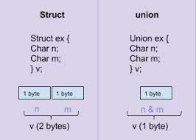

Slide 27
Accessing union members
To access the union members we can use same syntax like structures using a dot operator.
Code.a
Code.y
Code.c

Slide 28
Similarities between Structure and Union
Both are user-defined data types used to store data of different types as a single unit.
Their members can be objects of any type, including other structures and unions or arrays.
Both structures and unions support only assignment = and sizeof operators. The two structures or unions in the assignment must have the same members and member types.
A structure or a union can be passed by value to functions and returned by value by functions. The argument must have the same type as the function parameter. A structure or union is passed by value just like a scalar variable as a corresponding parameter.
‘.’ operator is used for accessing members.

Slide 29
difference
Structure
Union
Keyword struct
Individual members accessed at a time.
The size of the structure is greater than equal to the sum of sizes of its members.
Each member within a structure is assigned unique storage area location
Syntax:
struct num
{
int integer;
float decimal;
char name[20];
};
Keyword union
Only one member can access at a time
Size of union is equal to the size of largest member.
Memory allocated shared by individual members of unions.
Syntax:
union num
{
int integer;
float decimal;
char name[20];
};

Slide 30
Pointers
Declaration
Initialization

Slide 31
pointer
A pointer is a derived data type.
Pointer is a variable that stores address of another variable.
Pointer contain memory address as their values

Slide 32
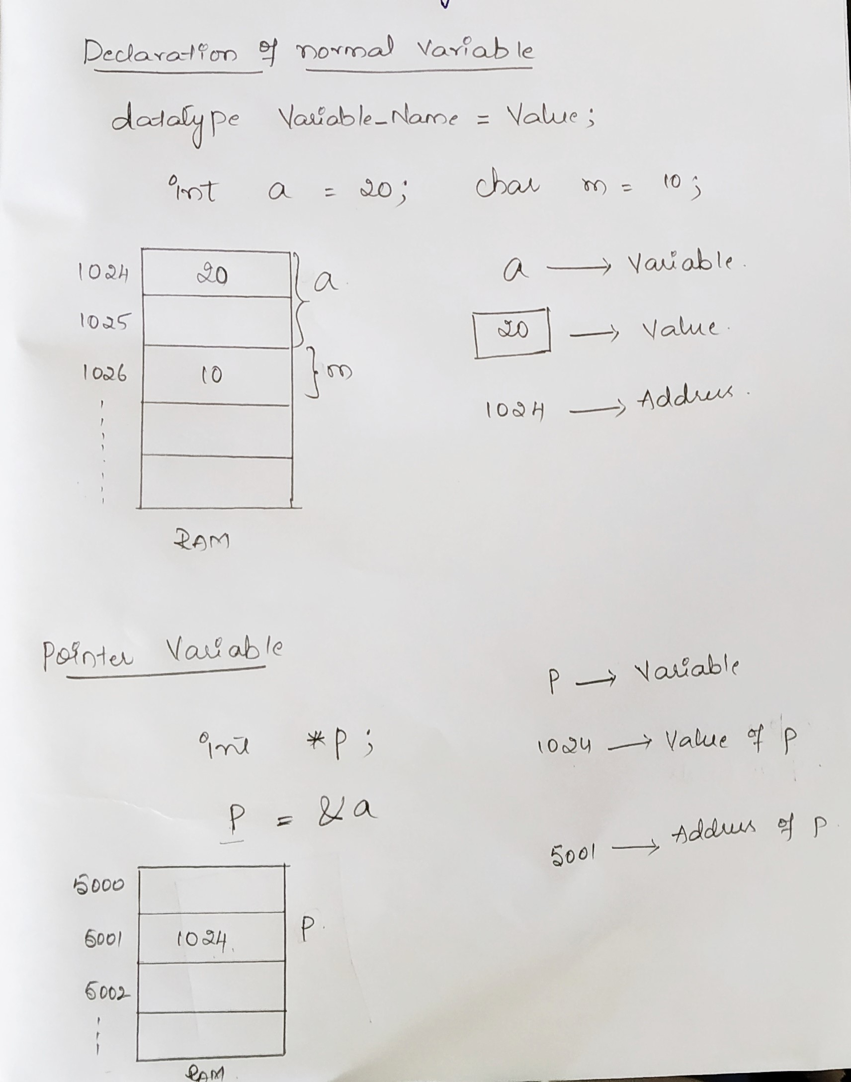

Slide 33
Accessig the address of variable
Actual address of variable is not known to programmer
Therefore we use & operator available in c to get the address of variable.
Eg.’ p = &a;
This assigns the address 1024 to the variable p.
&- is refered as ‘address of’
The & operator can be used only with a simple variable or an array.

Slide 34
Declaring pointer variable
Every variable in c programming must be declared first before it is used
Therefore pointer variable also should be declared
Syntax for pointer variable
data_type *pt_name;
Here
(*) tells that variable pt_name is a pointer variable
pt_name should be given a memory location
pt_name points to a variable of type data_type.
int *p; /*interger pointer*/
float *x /*float pointer*/
Declares a variable p as pointer variable that points to an integer datatype

Slide 35
Initializing pointer variable
Assigning the address of a variable to pointer variable is called initialization.
We can use assignment operator (=) to initialize the variable.
int a;
int *p; /*declaring pointer variable p*/
p = &a /*initializing */
Can also be initialized as
int *p = &a;
Or
int a, *p=&a;

Slide 36
Accessing variable through pointer
pointer is a variable that stores the address of another variable.
To access the value of variable using pointer we use (*) which is known as indirection operator or dereferencing operator.
When we dereference a pointer, then the value of the variable pointed by this pointer will be returned.
Dereferncing operator can be used to access or manipulate the data stored at the memory location, which is pointed by the pointer.

Slide 37
Example for accessing variable using pointer
First, we declare the integer variable to which the pointer points.
int a =20;
Now, we declare the integer pointer variable.
int *ptr;
After the declaration of an integer pointer variable, we store the address of 'x' variable to the pointer variable 'ptr'.
ptr=&a;
We can change the value of ‘a' variable by dereferencing a pointer 'ptr' as given below:
*ptr =10;
The above line changes the value of ‘a' variable from 20 to 10 because 'ptr' points to the ‘a' location and dereferencing of 'ptr', i.e., *ptr=10 will update the value of a.

Slide 38
Program for accessing variable values using pointer
#include<stdio.h>
int main()
{
int a=20;
int *ptr;
ptr=&a;
*ptr=10;
printf("value of a is : %d", a);
return 0;
}

Slide 39
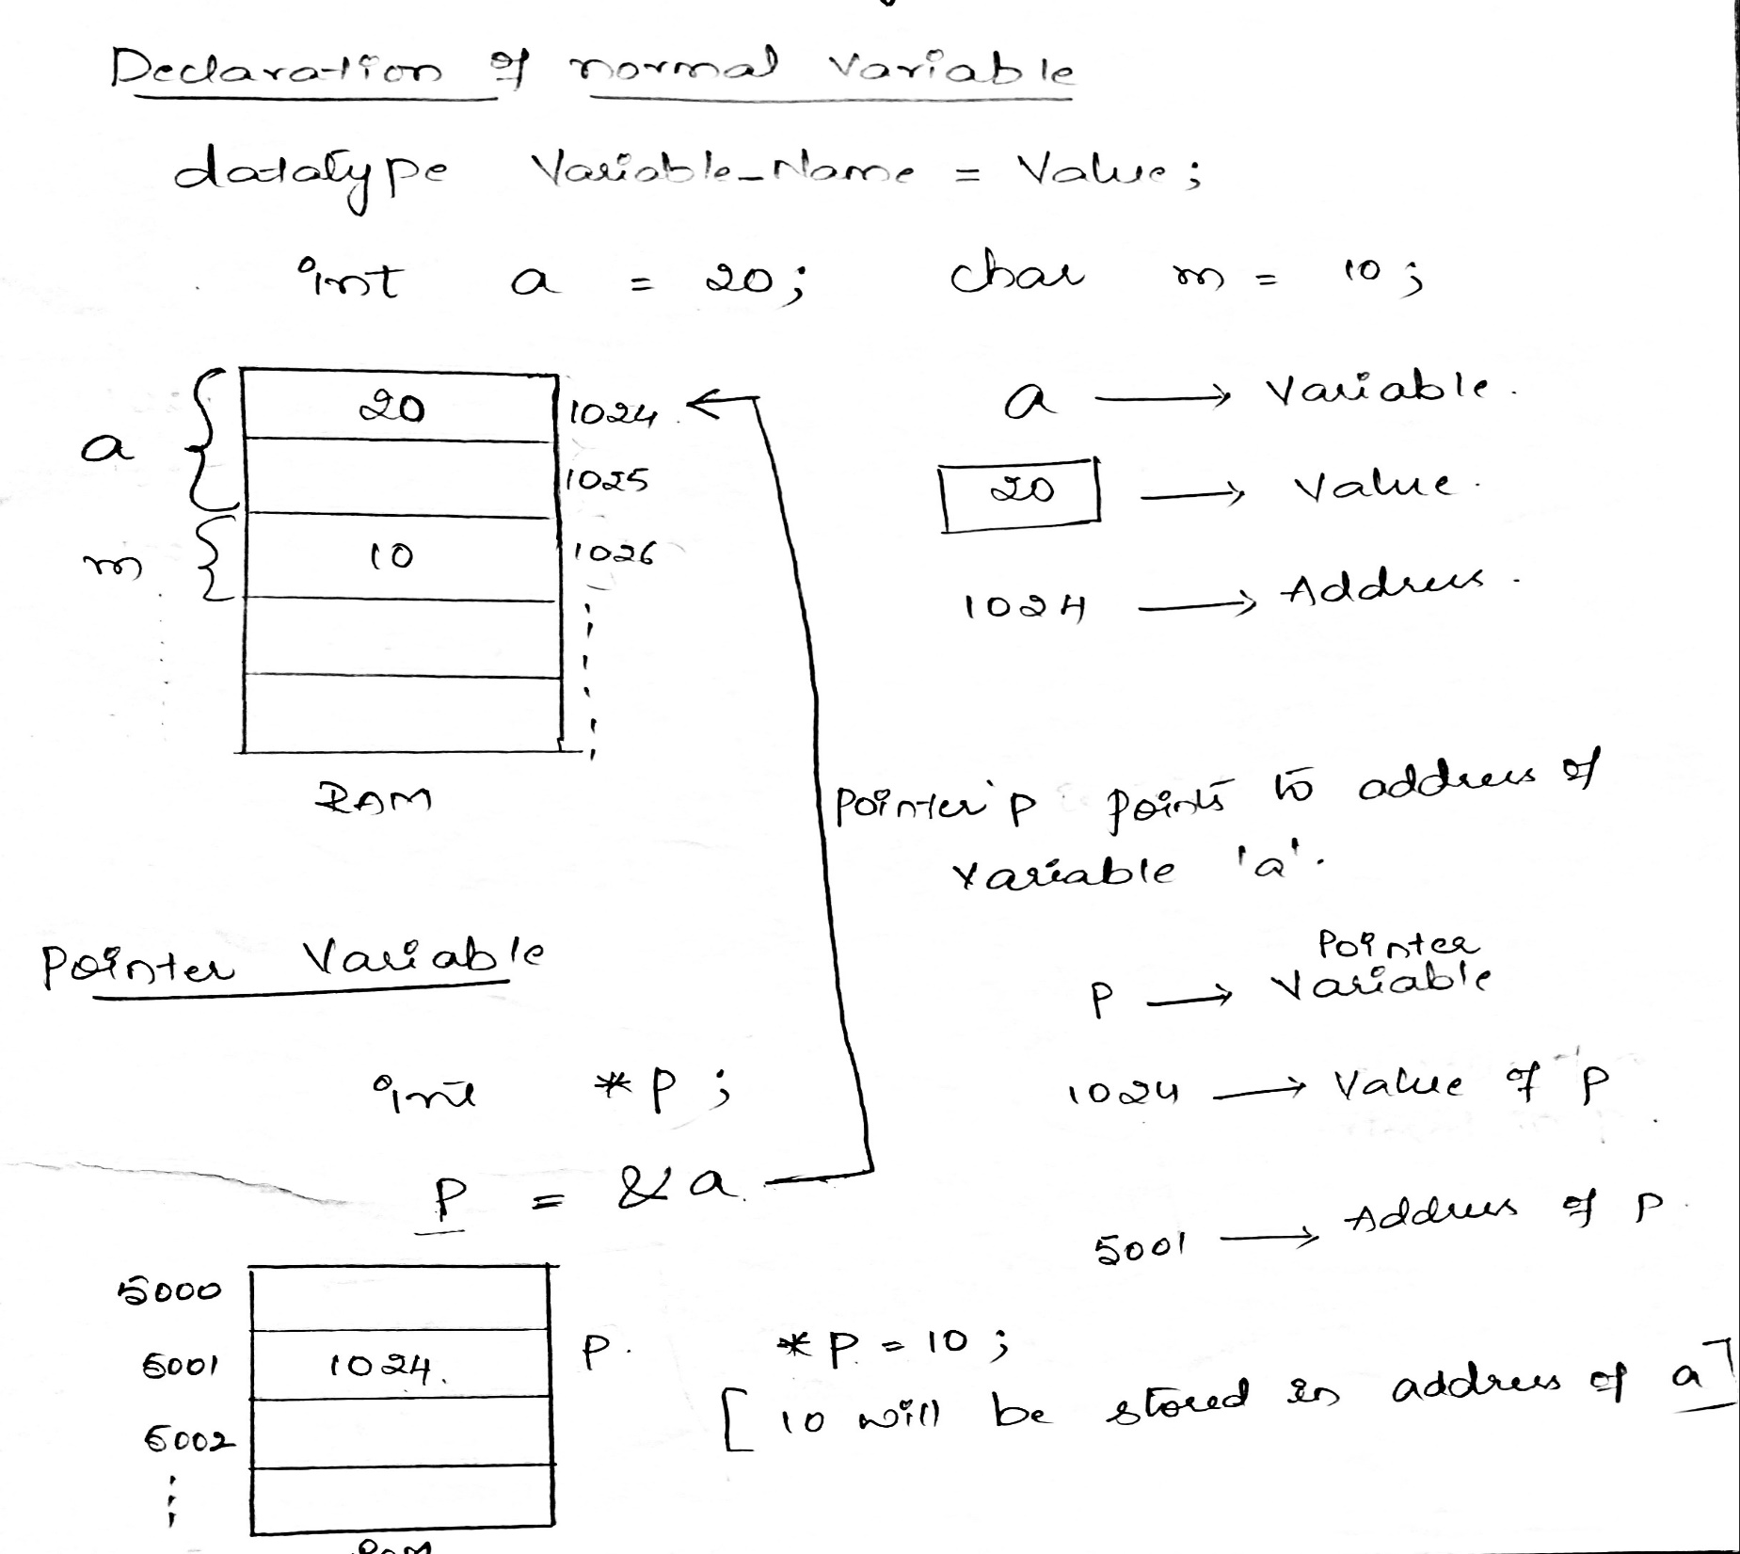

Slide 40
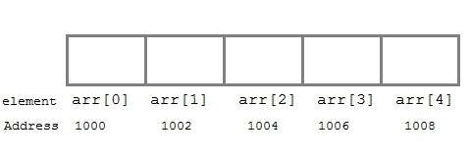
Pointers to arrays
When an array is declared, compiler allocates sufficient amount of memory to contain all the elements of the array.
Base address(index 0) i.e address of the first element of the array is also allocated by the compiler.
Suppose we declare an array arr
int arr[5] = { 1, 2, 3, 4, 5 };
Assuming that the base address of arr is 1000 and each integer requires two bytes, the five elements will be stored as follows:

Slide 41
arr has two purpose - it is the name of the array and it acts as a pointer pointing towards the first element in the array.
arr = &arr[0] //by default
We can also declare a pointer of type int to point to the array arr.
int *p;
p = arr;
// or,
p = &arr[0];
Now we can access every element of the array arr using p++ to move from one element to another.

Slide 42
Pointers to arrays program
#include <stdio.h>
int main()
{
int i;
int arr[5] = {1, 2, 3, 4, 5};
int *p = arr; // same as int*p = &arr[0]
for (i = 0; i < 5; i++)
{
printf("%d", *p);
p++;
}
return 0;
}

Slide 43
Pointers to structures
We have already learned that a pointer is a variable which points to the address of another variable of any data type like int, char, float etc.
Similarly, we can have a pointer to structures, where a pointer variable can point to the address of a structure variable.
We know, Structure members are accessed using (.) dot operator.
Let us see how to use pointers to access members of a structure.
If we have a pointer to structure, members are accessed using arrow ( -> ) operator.
* operator is used to point to value of variable
& operator is used to point to address of variable

Slide 44
How to declare pointer to structure
Define the structure
Declare the structure variable
Declare the pointer variable
Assign the address of structure variable with pointer variable

Slide 45
C program to access structure members using pointers
#include<stdio.h>
struct student /*defining a structure student*/
{
char name[20];
int rollno;
float marks;
};
int main()
{
struct student std1,*ptr;
ptr=&std1;
printf("enter name:\n");
scanf("%s",ptr->name);
printf("enter rollno:\n");
scanf("%d",&ptr->rollno);
printf("enter marks:\n");
scanf("%f",&ptr->marks);
printf("entered details of students are:\n");
printf("Name=%s\n",ptr->name);
printf("Rollno=%d\n",ptr->rollno);
printf("Marks=%f\n",ptr->marks);
}
Structure members
/*defining structure variable std1, pointer variable *ptr */
/*assign address of structure variable to pointer variable*/
/*Accessing structure member using pointer*/

Slide 46
Self referential structures
A structure which contains pointer to itself is known as self referential structure.
Pointer stores the address of the structure of same type.
Eg; linked list.
struct node node A node B node C
{
int value; address 1000 2000 3000
struct node *next;
}
here *next is pointer member will store the address of next structure which is of same type ie; structure
2 | 2000
5 | 3000
9 | NULL

Slide 47
Advantages of pointers
pointers increase the execution speed and thus reduce the program execution time
Pointers allow c to support dynamic memory management.
Pointers are more efficient in handling arrays and data tables.
Pointers can be used to return multiple values from a function via function arguments.
The use of pointer arrays to character strings results in saving of data storage space in memory.
Pointers reduce length and complexity of programs.

